Slide 1
Business Level Strategy
Unit - 3

Slide 2
An organization’s core competencies should be focused on satisfying customers’ needs and wants in order to achieve better than average returns.
actions to be taken to provide value to customers and gain a competitive advantage, by exploiting core competencies.
is concerned with a firm’s position in the industry, in relation to its competitors and to the five forces of competition
Who will be served, what needs are to be met, and how those needs will be satisfied, are determined by the senior management, while drafting Business Level Strategies
Who are the customers?
How to satisfy customer needs?
Business level strategy is concerned with issues such as:
Identifying and meeting the needs of key customers
Achieving advantage over competitors
Avoiding competitive disadvantage

Slide 3
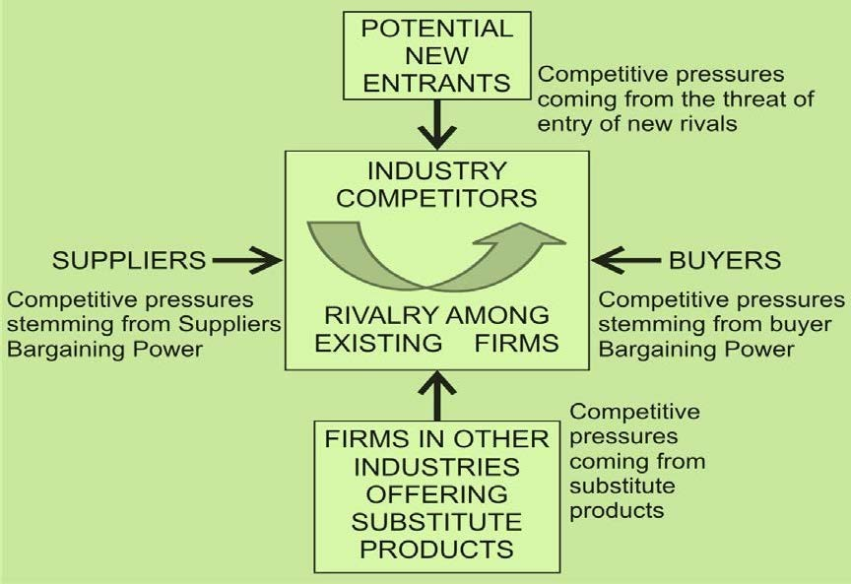
PORTER’S FIVE FORCES MODEL- COMPETITIVE ANALYSIS

Slide 4
Threat of New Entrants
New entrants can reduce an industry’s profitability
The bigger the new entrant, the more severe the competitive effect.
Common barriers to entry include:
Capital requirements
Economies of scale
Product differentiation
Switching costs
Brand identity
Access to distribution channels
Possibility of aggressive retaliation by existing players

Slide 5
Capital Requirements: When a large amount of capital is required to enter an industry, firms lacking funds are effectively barred from that industry, thus, enhancing the profitability of existing firms.
Economies of Scale: Economies of scale refers to the decline in the per-unit cost of production (or other activity) as the volume grows. A large firm that enjoys economies of scale can produce high volumes of goods at successively lower cost.
Product Differentiation: Product differentiation refers to the physical or perceptual differences, or enhancements, that make a product special or unique in the eyes of customers.
Switching Costs: To succeed in an industry, new entrant must be able to persuade existing customers of other companies to switch to its products.
Brand Identity: The brand identity of products or services offered by existing firms can serve as another entry barrier.
Access to Distribution Channels: The unavailability of distribution channels for new entrants poses another significant entry barrier.
Possibility of Aggressive Retaliation: Sometimes the mere threat of aggres- sive retaliation by incumbents/existing firms can deter entry of new firms into an existing industry.

Slide 6
Bargaining Power of Buyers
force becomes heavier depending on the possibility of buyers forming groups or cartels.
( Industrial products)
The bargaining power of the buyers influences not only the prices that the producer can charge but also influences costs and investments of the producer.
This is because powerful buyers usually bargain for better services which involves more investment on the part of the producer.
Buyers of an industry’s products or services can sometimes exert considerable pressure on existing firms to secure lower prices or better services. This leverage is particularly evident when;
Buyers have full knowledge of the source(s) of products and their substitutes.
Big buyers: in a position to demand favourable terms of contract.
The industry’s product is not perceived as critical to the buyer’s needs and buyers are more concentrated than firms supplying the product. They can easily switch to the substitutes available.

Slide 7
Bargaining Power of Suppliers
considerable bargaining power over purchasing companies.
when the suppliers are limited in number, they may openly exhibit their bargaining power.
determines the cost of raw materials
Suppliers can command bargaining power over a firm when;
Their products are crucial to the buyer and substitutes are not available.
They can erect/ensure high switching costs.
They are more concentrated than their buyers. Less suppliers, more buyers

Slide 8
The Nature of Rivalry in the Industry
the competitors influence strategic decisions at different strategic levels.
The impact is more evident at functional level, like in the prices being charged, more aggressive advertising, and building pressures on costs, product and so on.
The intensity of rivalry can influence the costs of suppliers, distribution, and of attracting customers and thus, can directly affect the profitability.
“The more intensive the rivalry, the less attractive is the industry”.

Slide 9
Rivalry among competitors tends to be cutthroat and an industry’s profitability is low when;
An industry has no clear leader. Therefore, continuous war for leadership.
Competitors in the industry are numerous.
Competitors operate with high fixed costs. Thus, aiming for better Return on Investment with more fierce tactics.
Competitors face high exit barriers, and therefore, continue to fight for mar- ket share.
Competitors have little opportunity to differentiate their offerings.
The industry faces slow or diminished growth.

Slide 10
Industry Leader: A strong industry leader can discourage price wars by disciplining initiators of such activity.
Number of Competitors: Even when an industry leader exists, the leader’s ability to exert pricing discipline diminishes with the increased number of rivals in the industry as communicating expectations to players becomes more difficult.
Fixed Costs: When organisations operate with high fixed costs, they are motivated to utilize their capacity and therefore, are inclined to drop prices when they have excess capacity.
Exit Barriers: Rivalry amongst competitors declines, if a few competitors leave the industry. Profitability therefore tends to be higher in industries with few exit barriers.
Product Differentiation: Firms can sometimes insulate themselves from price wars by differentiating their products from those of its rivals. As a con- sequence, profitability tends to be higher in industries that offer opportunity for differentiation.
Slow Growth: Industries whose growth is declining tend to face more intense rivalry.

Slide 11
Threat of Substitutes
Substitute products are a latent/hidden but existing source of competition in an industry.
Substitute products that offer a price advantage and/or performance improvement to the consumers, can drastically alter the competitive character of an industry.
To predict profit pressure from this source of competition, firms must search for products that can perform the same, or nearly the same, functionalities as their own products.
The threat of substitutes is great in many high tech industries as well.

Slide 12
Activity
Select an industry of your choice. Identify Porter’s five-forces of competition in that industry. Perform a competitor analysis from the point of view of the market leader in that industry. Identify the possible strategic groups in that industry and judge the implications of such groups on the strategies of the market leader.

Slide 13
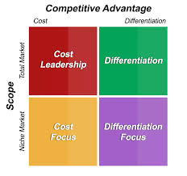
MICHAEL PORTER’S GENERIC STRATEGIES
Once we identify these forces and their corresponding strength, the task at hand for the management is to respond to these forces strategically.
strategies allow organizations to gain competitive advantage from three different bases: cost leadership, differentiation, and focus.

Slide 14
Cost leadership emphasizes on producing standardized products at a very low per- unit cost for consumers who are price-sensitive.
Differentiation is a strategy aimed at producing products and services considered unique industry-wide and directed at consumers who are relatively price-insensitive.
Focus means producing products and services that fulfil the needs of small groups of consumers with very specific taste.
Cost Leadership Strategy
It is a low-cost competitive strategy that aims at broad mass market.
Striving to be a low-cost producer in an industry can especially be effective,
when the market is composed of many price-sensitive buyers and
when there are few ways to achieve product differentiation.

Slide 15
A successful cost leadership strategy usually permeates the entire firm, as evidenced by high efficiency, low overheads, limited perks, intolerance of waste, in- tensive screening of budget requests, wide span of controls, rewards linked to cost containment, and broad employee participation in cost control efforts.
Some risks of pursuing cost leadership are;
that competitors may imitate the strategy, therefore driving overall industry profits down;
that technological breakthroughs in the industry may make the strategy ineffective; or that buyer interests may swing to other differentiating features besides price.

Slide 16
Advantages of Cost Leadership Strategy
Earlier we have discussed Porter’s Five Forces Model in detail. A cost leadership strategy may help to remain profitable even with: rivalry, new entrants, suppliers’ power, substitute products, and buyers’ power.
Rivalry – Competitors are likely to avoid a price war, since the low-cost firm will continue to earn profits even after competitors compete away their prof- its.
Buyers – Powerful buyers/customers would not be able to exploit the cost leader firm and will continue to buy its product.
Suppliers – Cost leaders are able to absorb greater price increases from sup- pliers before they need to raise prices for customers.
Entrants – Low-cost leaders create barriers to market entry through their con- tinuous focus on efficiency and cost reduction.
Substitutes – Low-cost leaders are more likely to lower the costs to induce existing customers to stay with their products, invest in developing substi- tutes, and even purchase patents.

Slide 17
Disadvantages of Cost Leadership Strategy
Cost advantage may not last long as competitors may imitate cost reduction techniques.
Cost leadership can succeed only if the firm can achieve higher sales volume.
Cost leaders tend to keep their costs low by minimizing cost of advertising, market research, and research and development, but this approach can prove to be expensive in the long run.
Technological advancement is a great threat to cost leaders.

Slide 18
Differentiation strategy
This strategy is aimed at broad mass market and involves the creation of a product or service that is perceived by the customers as unique. The uniqueness can be associated with product design, brand image, features, technology, dealer network or customer service.
For example, Domino’s Pizza has been offering home delivery within 30 minutes or the order is free, is a unique selling point that differentiates if from its rivals.
Successful differentiation can mean greater product flexibility, greater compatibility, lower costs, improved service, less maintenance, greater convenience, or more features.
A risk associated with pursuing a differentiation strategy is that the unique product may not be valued high enough by customers to justify the higher price. When this happens, a cost leadership strategy will easily defeat a differentiation strategy.
For example, Amazon Prime offers deliver within two hours. This is quite difficult to imitate by its rivals, and thus this differentiating factor helps it to lead the market.

Slide 19
Advantages of Differentiation Strategy
A differentiation strategy may help an organisation to remain profitable even with: rivalry, new entrants, suppliers’ power, substitute products, and buyers’ power.
Rivalry - Brand loyalty acts as a safeguard against competitors. It means that customers will be less sensitive to price increases, as long as the firm can satisfy the needs of its customers.
Buyers – They do not negotiate for price as they get special features and they have fewer options in the market.
Suppliers – Because differentiators charge a premium price, they can afford to absorb higher costs of supplies as the customers are willing to pay extra too.
Entrants – Innovative features are an expensive offer. So, new entrants gen- erally avoid these features because it is tough for them to provide the same product with special features at a comparable price.
Substitutes – Substitute products can’t replace differentiated products which have high brand value and enjoy customer loyalty.

Slide 20
Disadvantages of Differentiation Strategy
In the long term, uniqueness is difficult to sustain.
Charging too high a price for differentiated features may cause the customer to switch-off to another alternative. As we see a shift of iPhone users to other android flagship smart phones.
Differentiation fails to work if its basis is something that is not valued by the customers.

Slide 21
Focus Strategy
Focus strategies are most effective when consumers have distinctive preferences or requirements, and when the rival firms are not attempting to specialize in the same target segment.
An organization using a focus strategy may concentrate on a particular group of customers, geographic markets, or on particular product-line segments in order to serve a well-defined but narrow market better than competitors who serve a broader market.
For example, Ferrari sports cars.
Focused cost leadership and Focused differentiation

Slide 22
Advantages of Focused Strategy
Premium prices can be charged by the organisations for their focused prod- uct/services.
Due to the tremendous expertise in the goods and services that the organi- sations following focus strategy offer, rivals and new entrants may find it dif- ficult to compete.
Disadvantages of Focused Strategy
The firms lacking in distinctive competencies may not be able to pursue focus strategy.
Due to the limited demand of product/services, costs are high, which can cause problems.
In the long run, the niche could disappear or be taken over by larger com- petitors by acquiring the same distinctive competencies.

